Slide 1
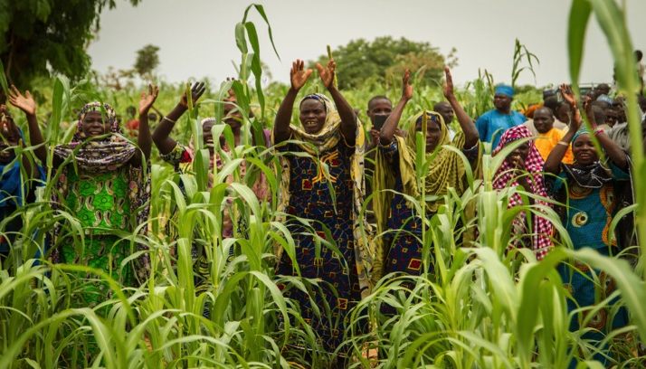
Equator Initiative Year in Review
October 2015
Eileen de Ravin, Manager, Equator Initiative

Slide 2
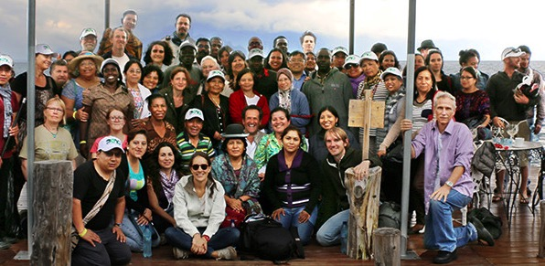
International Training and Dialog Workshops in Guatemala
Community-based Monitoring, Indicators on Traditional Knowledge
Assessment of Collective Action in Biodiversity Conservation Resource Mobilization

Slide 3
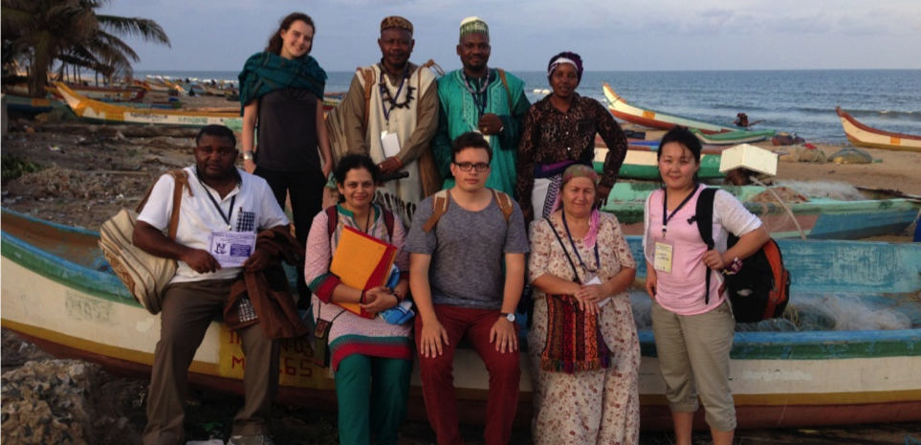
Access and Benefits Sharing (ABS) Workshops in India
ABS and the conservation, protection, and valorization of biodiversity and traditional knowledge
Capacity Building Exchanges & Workshops for Traditional Knowledge Holders

Slide 4
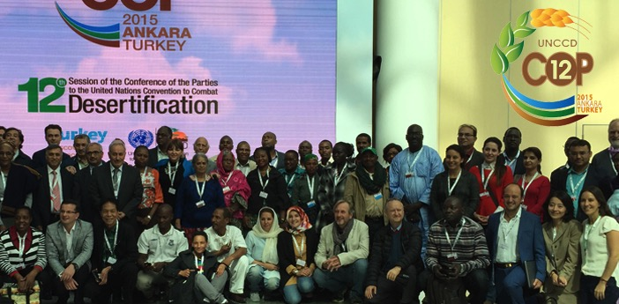
UNCCD COP 12 in Ankara, Turkey
Day for Indigenous and Local Community Sustainable Land Managers
October 14
Community Dialogues and Expert Panels

Slide 5
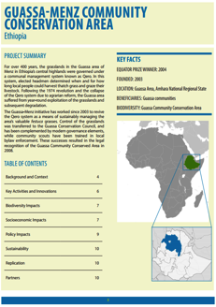
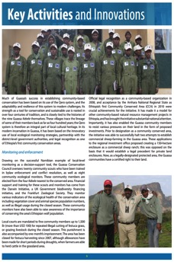
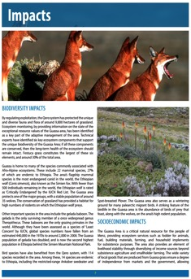
Case Studies
Sustainable Land Management
Series Launched
Focus on sustainable management of drylands in sub-Saharan Africa
12 case studies published this year

Slide 6
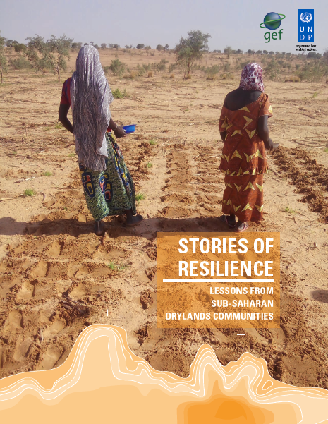
Stories of Resilience
Book Launch
15 case studies in collaboration with Enda Tiers Monde
Sustainable management of drylands
Sub-Saharan Africa

Slide 7
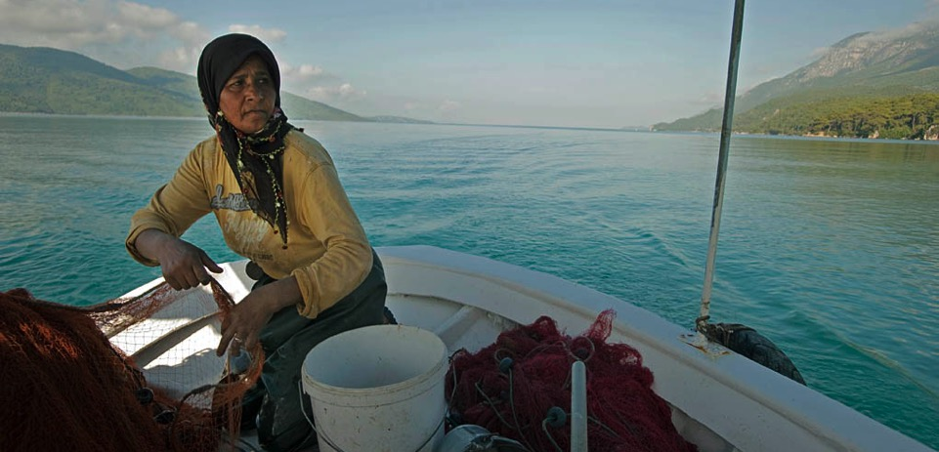
Equator Prize 2015
21 outstanding local initiatives advancing sustainable development solutions will be recognized at UNFCCC COP 21 in Paris
1,461 nominations were received this year

